Slide 1


Understanding BIG DATA AND HADOOP By Priti Bhardwaj, Cdac Noida

Slide 2
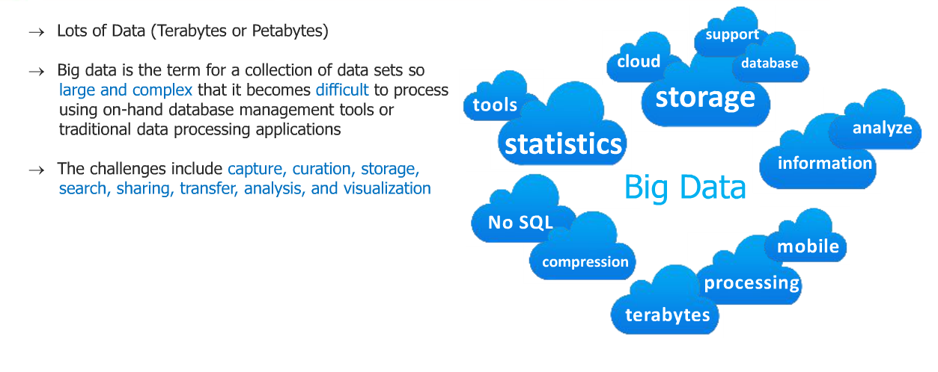
What is big data

Slide 3
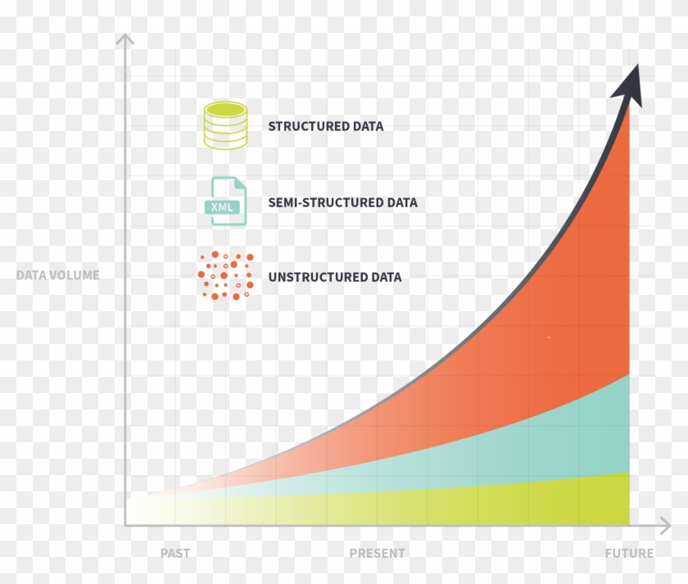
Unstructured data is exploding

Slide 4
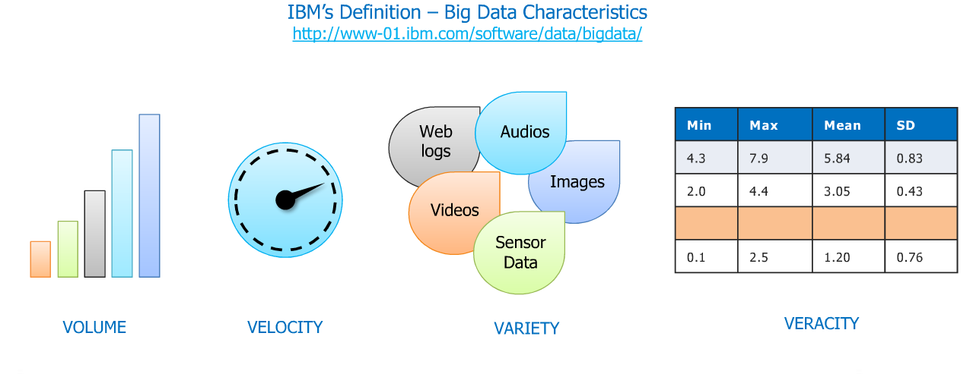
IBM Definition of big data
VALUE

Slide 5

Types of Big Data
Big Data could be of three types:
Structured
Semi-Structured
Unstructured

Slide 6
Examples of Big Data
Walmart handles more than 1 million customer transactions every hour.
Facebook stores, accesses, and analyzes 30+ Petabytes of user generated data.
230+ millions of tweets are created every day.
More than 5 billion people are calling, texting, tweeting and browsing on mobile phones worldwide.
YouTube users upload 48 hours of new video every minute of the day.
Amazon handles 15 million customer click stream user data per day to recommend products.
294 billion emails are sent every day. Services analyses this data to find the spams.
Modern cars have close to 100 sensors which monitors fuel level, tire pressure etc. , each vehicle generates a lot of sensor data.

Slide 7
Challenges with Big Data
Data Quality
Discovery
Storage
Analytics
Security
Lack of Talent

Slide 8



Big Data Applications
Healthcare
Telecommunication
Finance

Slide 9


Big Data Applications
Education
Automobile

Slide 10

Big Data in Government
Cyber security & Intelligence
Crime Prediction and Prevention
Pharmaceutical Drug Evaluation
Scientific Research
Weather Forecasting
Tax Compliance
Traffic Optimization
Air traffic
Web &e tailing:recommmendations
Twitter
Marketing engine

Slide 11
Real time scenarios
Facebook: Ad targeting
Air traffic
Web &e tailing:recommmendations
Twitter
Marketing engine

Slide 12
User A: rollex watch, mac laptop, I phone
User B : rollex watch, mac laptop

Slide 13
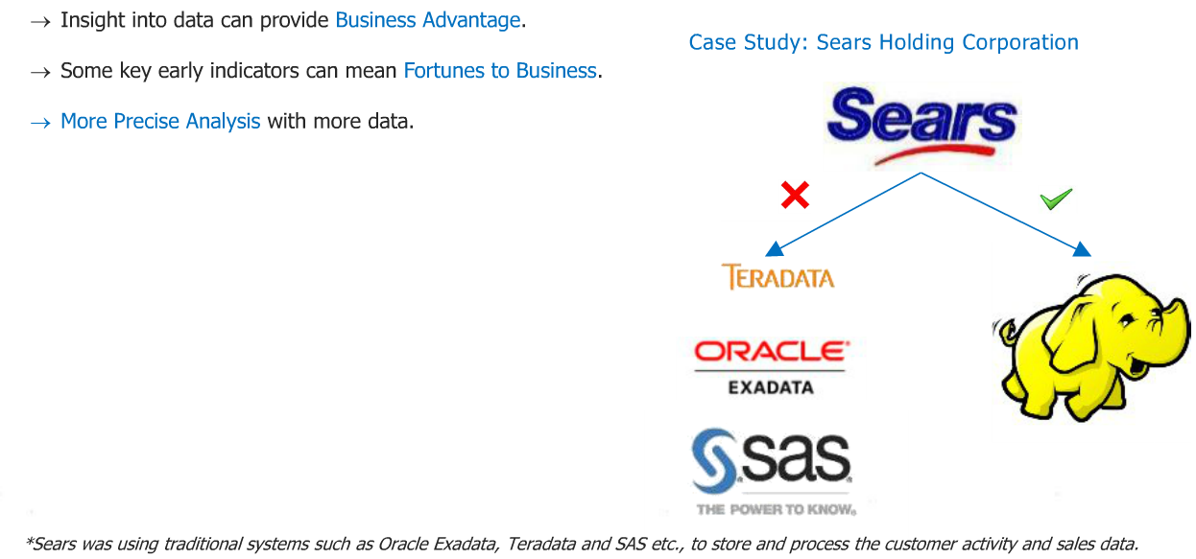
Sears use analysis

Slide 14
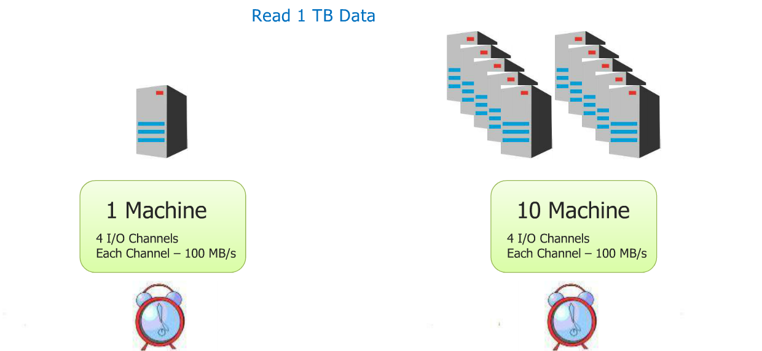
WHY DFS? Distributed file system

Slide 15
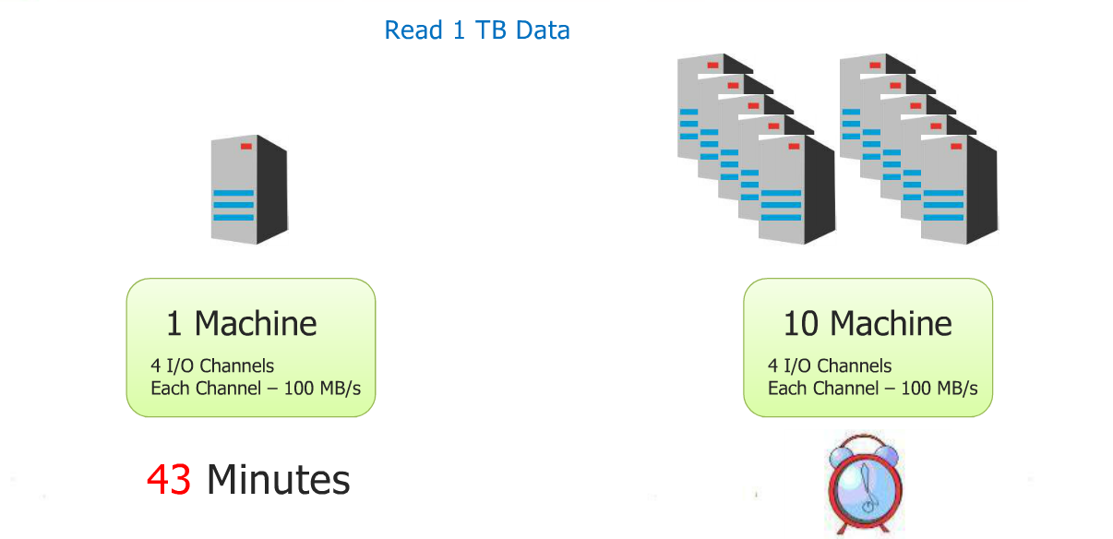

Slide 16
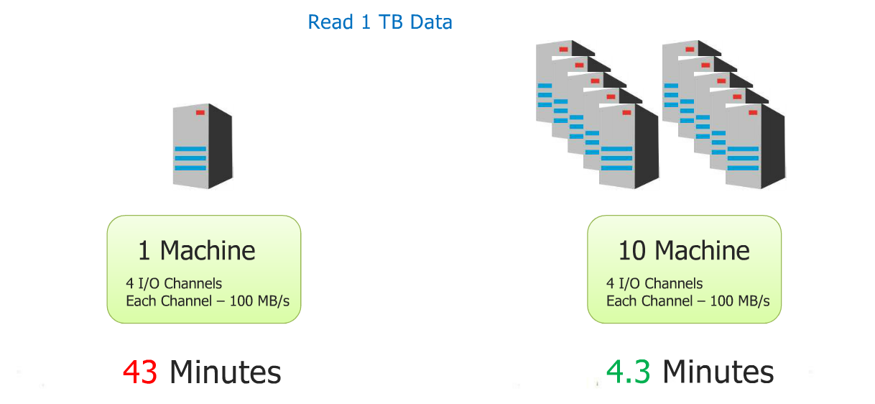

Slide 17
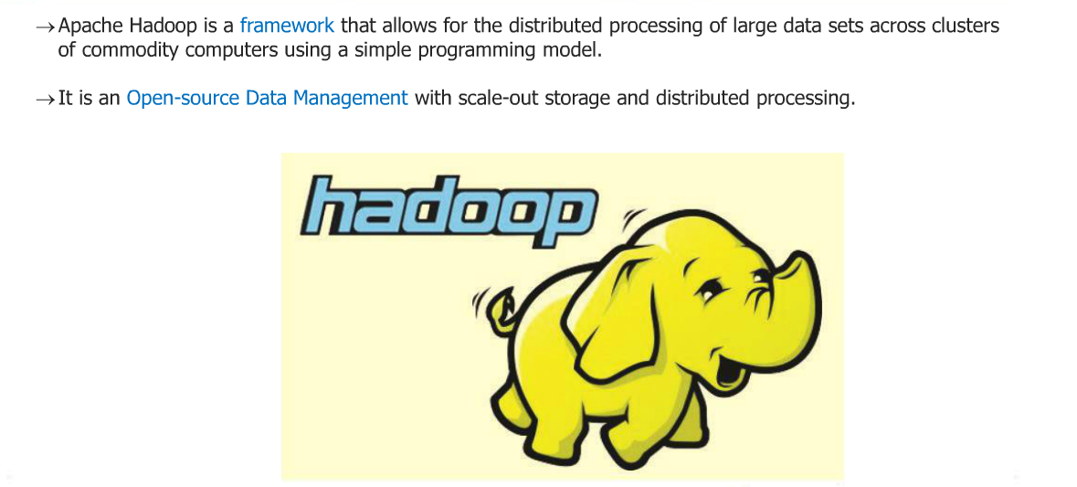
What is Hadoop?

Slide 18
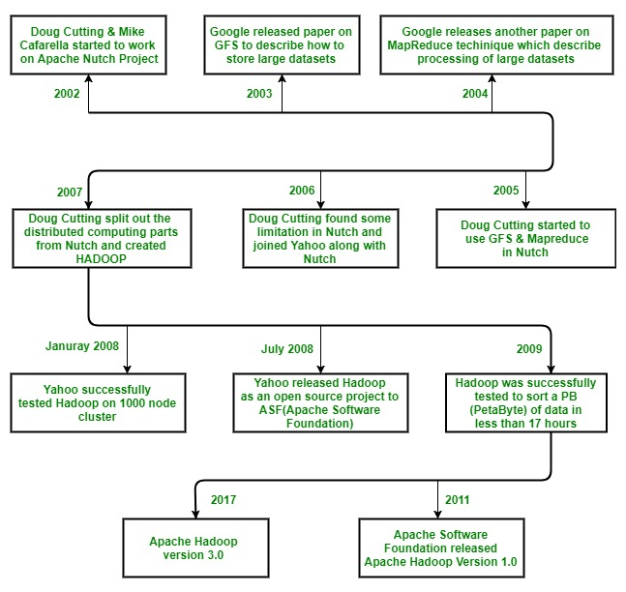
Hadoop History

Slide 19
Hadoop was created by Doug Cutting and Mike Cafarella in 2005. Cutting, who was working at Yahoo! at the time, named it after his son's toy elephant. It was originally developed to support distribution for the Nutch search engine project.

Slide 20
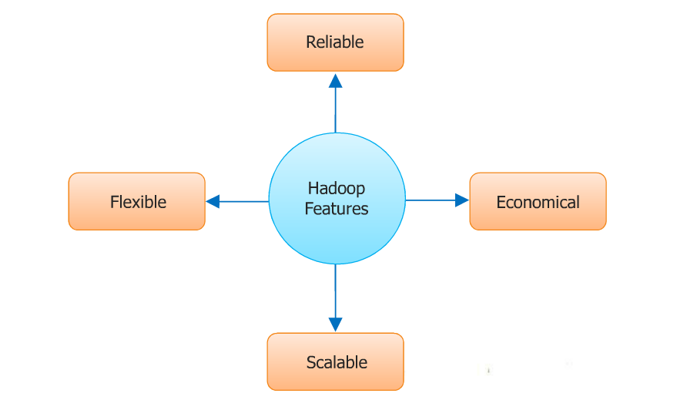
Characterstics

Slide 21
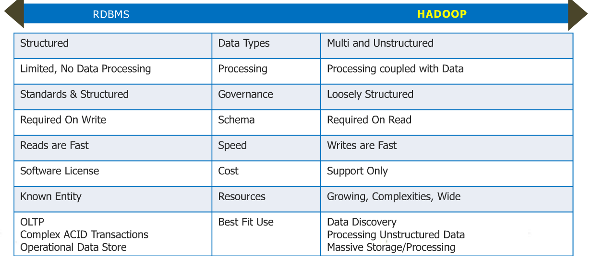
Hadoop-its about scale and structure

Slide 22
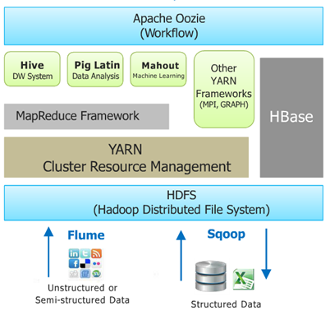
Hadoop ecosystem

Slide 23
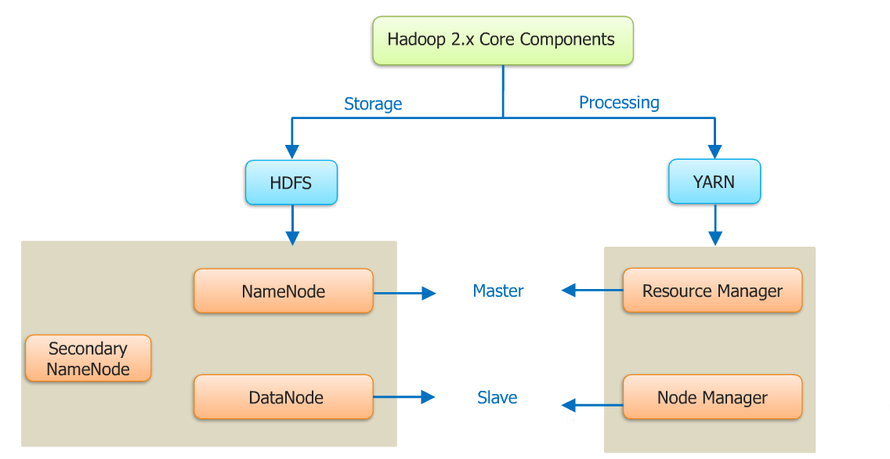
Hadoop 2.X core components

Slide 24
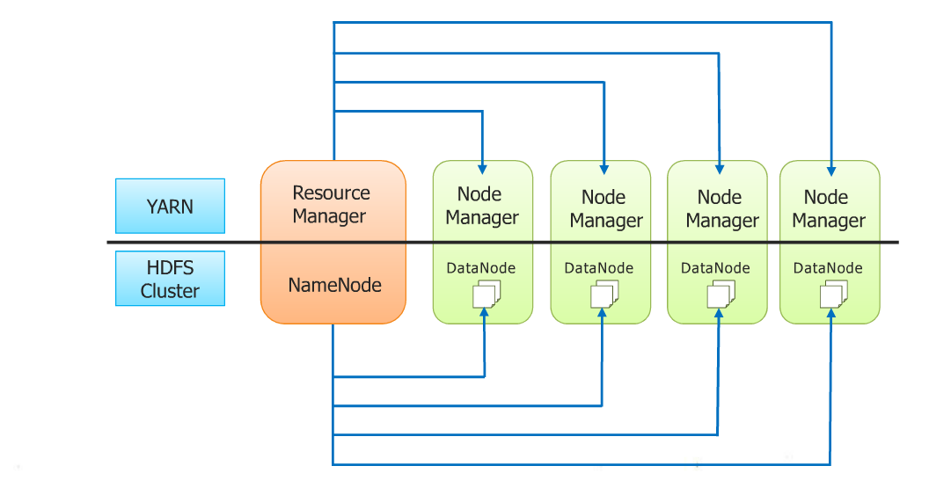

Slide 25
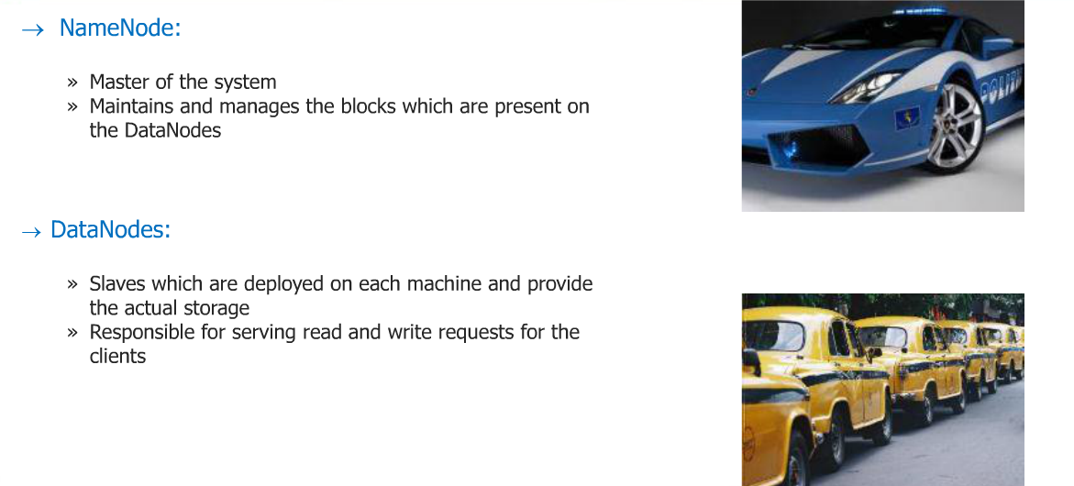
Main components of HDFS

Slide 26
Secondary namenode
Secondary NameNode
Query for EditLogs at regular intervals
NameNode
Updates FsImage image with EditLogs
FsImage
Copy updated FsImage back to NameNode
FsImage

Slide 27
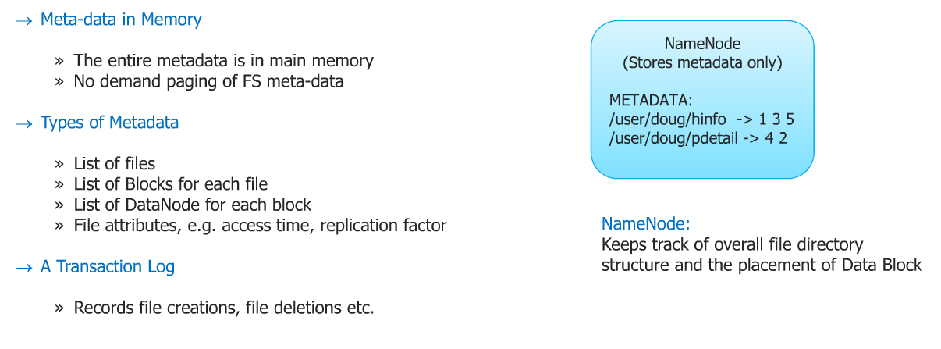
Name Node Metadata

Slide 28
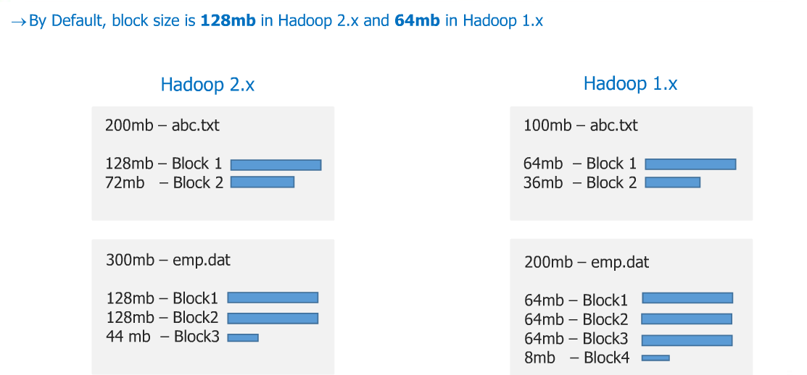
File Blocks

Slide 29
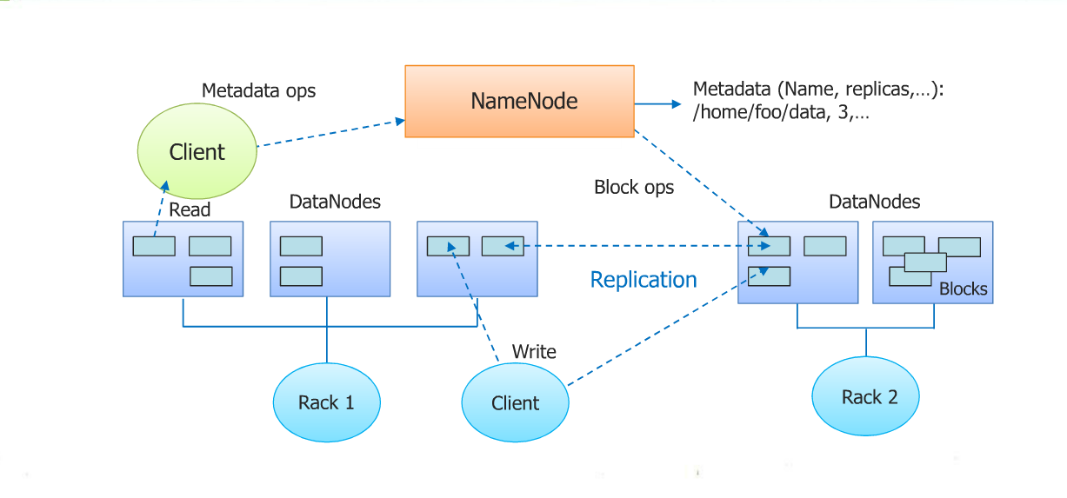
HDFS Architecture

Slide 30
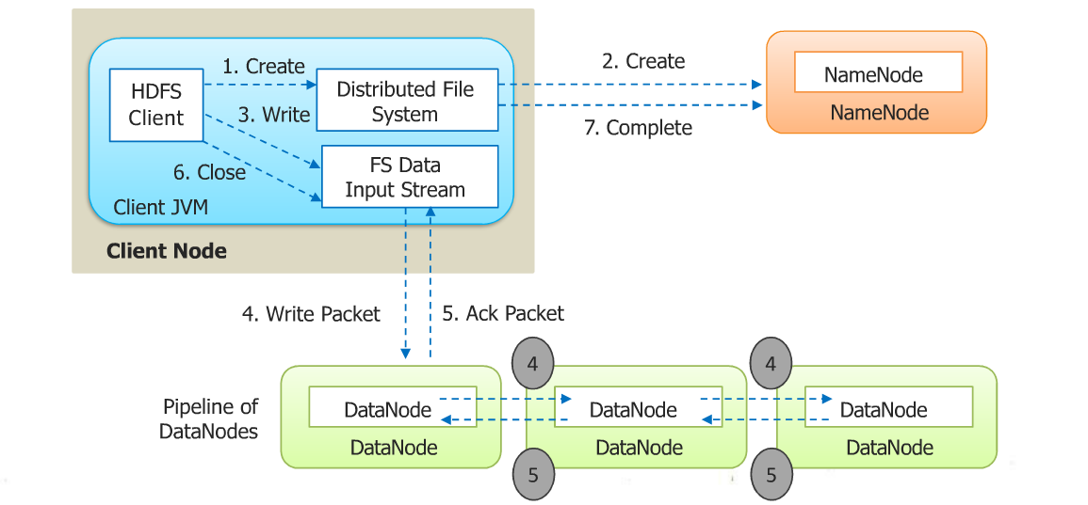
Anatomy of a file write

Slide 31
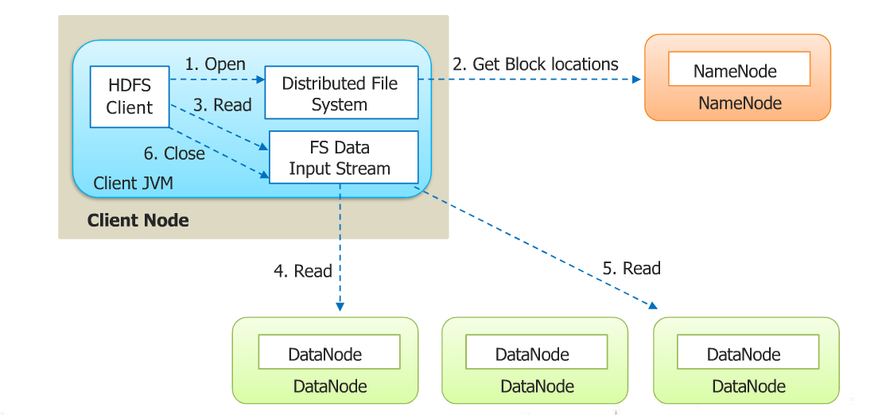
Anatomy of a file read

Slide 32
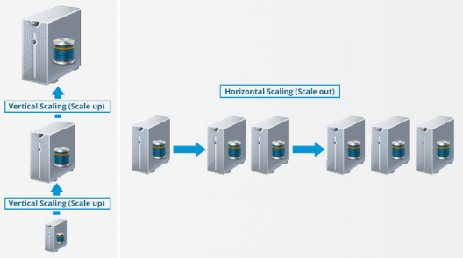
Advantages Of HDFS
Distributed Storage
Distributed & Parallel Computation
Horizontal Scalability

Slide 33
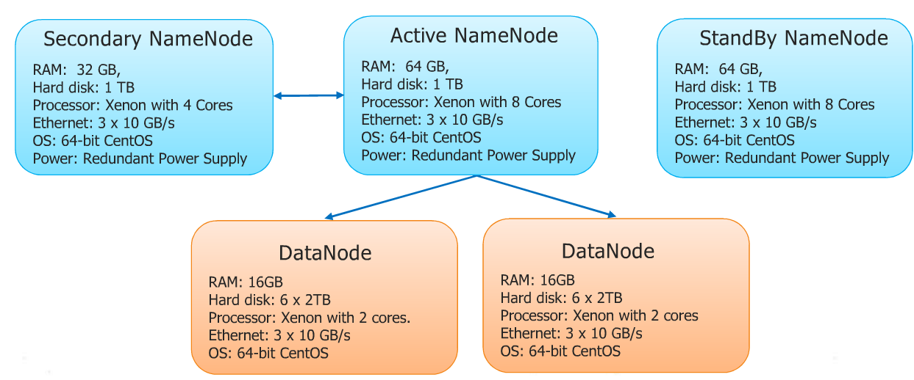
Hadoop cluster:a typical use case

Slide 34
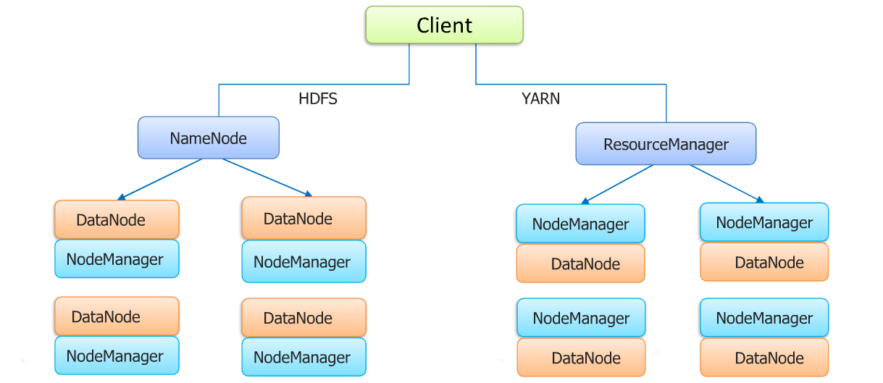

Slide 35
HDFS Federation improves the existing HDFS architecture through a clear separation of namespace and storage, enabling generic block storage layer. It enables support for multiple namespaces in the cluster to improve scalability and isolation.
Hadoop federation uses multiple independent namenodes/namespaces. The namenodes are federated, that is, the namenodes are independent and don’t require coordination with each other. Each Namenode is responsible to manage a portion of the file system there by sharing the workload of the cluster. The datanodes are used as common storage for blocks by all the namenodes. Each datanode registers with all the namenodes in the cluster. Datanodes send periodic heartbeats and block reports and handles commands from the namenodes.
A Block Pool is a set of blocks that belong to a single namespace. Datanodes store blocks for all the block pools in the cluster.

Slide 36
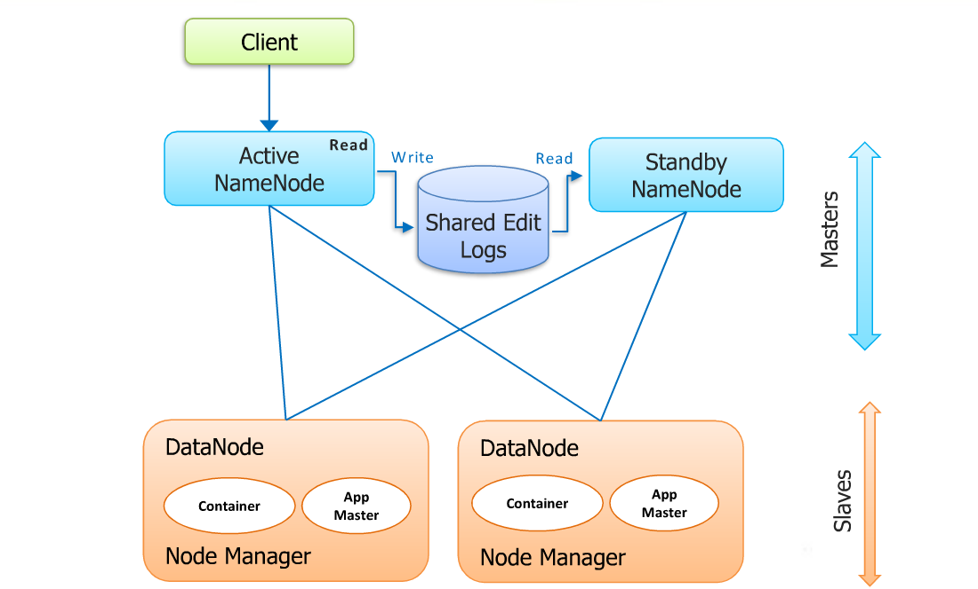
Cont..

Slide 37
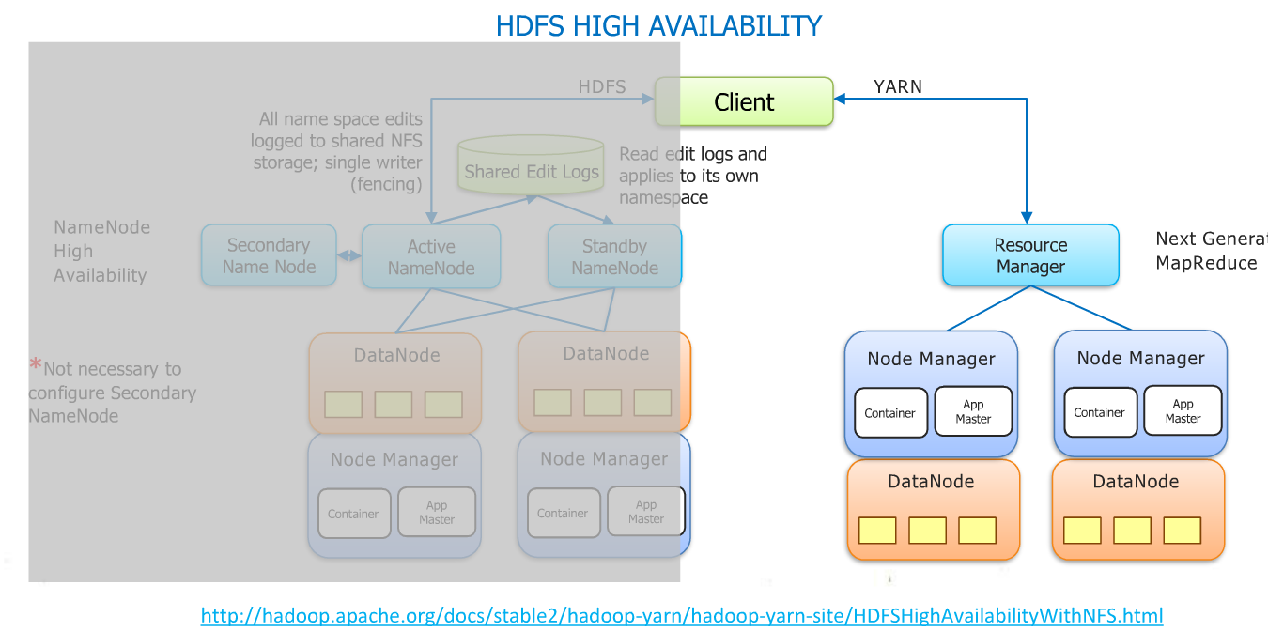
Hadoop 2.x-Resource management

Slide 38
Thank You

